Slide 1

Introduction to AI, Spring 2023 Agents and Environments

Slide 2
Introducing Agents
What did we say an agent was last time?
Something that acts!
And other things too
Operates persistently
Adapts to change
Creates and pursues goals
Stuff like that!
Lots of new vocab today.
Notes:
Perceives states state, operates persistently, adapts to change, pursues, creates goals, etc.
Today, we’re going to dive a little bit more in into what makes up an agent, and the environments that they live in. There’s a lot of terminology used to describe different types of problems you might find, and one of the big goals for today is to feel comfortable with that vocab.

Slide 3
Introducing Agents
An Agent (be it software or hardware) has Two Big Things:
Sensors: To perceive its environment.
Actuators: To act upon the environment.
Actuator
Actuator
Sensor
Notes:
So, we’ve got our little iron giant buddy here. What is the most likely “sensor” that he has here?
--Yeah, his eyes! They’ve probably got cameras or something that let him look around!
What actuators do we see? What are the most obvious ones?
--Probably his hands!
Anything else?
--He’s got like a stereo or something in his mouth, some audio out so he can make noises!

Slide 4
Introducing Agents
And then there is the matter of being in an environment.
Agent
Environment
Sensors
?
Actuators
Notes:
So there’s the idea that the agent is inside of some environment and it “reads in” data, it takes in input about the environment, via its sensors. It then takes what it learns and it “does something” to decide what to do next, what course of action would make it happiest. And then, once it’s figured it out, it then calls upon it’s actuators to be the change it wishes to see in the world, and to affect it’s environment to suit it’s needs.

Slide 5
Introducing Microworlds
Microworlds are commonly used.
Small environments with simple agents that let you focus on specific problems
Blocks World is a famous first example
Initial State and Goal State
Notes:
Working with limited worlds is often a way that we begin to make traction with difficult AI problems.
Block World allowed some early work in Natural Language Processing – to be able to “tell” the computer what you wanted it to do, or what you wanted a particular goal configuration of blocks to look like.
Different AI systems and planners were created so that it could “figure out” what it would need to do to be able to figure it out the solution.
Relatively small number of words “cube”, “cone”, “pyamid” helped it out a lot.

Slide 6
Vacuum World
An even simpler world!
Environment
Room A
Room B
Dirt (room has it or doesn’t)
Agent
Room Sensor – Where Am I?
Dirt Sensor – Is it Clean?
Motor – Can move around
Vacuum – Removes dirt
A
B
Notes:
To illustrate some properties of agents, we’re going to use a Vacuum World!
We’ll define it in terms of the environment that we have, and the agent that lives in it.
The environment is two rooms – A and B, and already we see this is an abstraction – you can only be in one room at a time. Discrete rooms here, unlike continuous where you can maybe straddle between two rooms at once in real life.
And a Room can be Dirty or Clean – no middle ground.
The agent has a room sensor – it knows what room its in
Dirt Sensor – is it clean or not
And actuators:
Motor – allows it to move around
Vacuum – allows it to clean up.

Slide 7
Percept
Two more fancy terms:
Percept:
An agent’s perceptual inputs at any given instant.
“I’m in Room A, it is clean!”
Percept Sequence:
The complete history of everything the agent has ever perceived.
“I’m in Room A, it is clean!” ; “I’m in Room B, it is dirty!” “I’m in Room B, it is clean!”
In general, an agent’s choice of action at any given instant can be determined by the entire percept sequence observed to date.
Notes:
Two new fancy terms: percept and percept sequence
--in general, agent’s choice depends on entire percept sequence
--If we can specify the choice of action for *every possible percept sequence* then we’ve said every single thing there is to say about the agent.

Slide 8
From Perception to Action
A function:
Takes in input, produces output.
AKA maps input to output
e.g., f(x) = 2x maps, say, 3 to 6, 10 to 20, etc.
An agent function:
Maps a percept sequence to an action.
Let’s say a percept takes the form [ROOM, STATE]
i.e., at any given instant, the agent knows the room it’s in, and if it’s dirty.
Percept Sequence | Action
[A, Clean] | Right
[A, Dirty] | Suck
[B, Clean] | Left
Percept Sequence | Action
[A, Clean],[A, Clean] | Right
[A, Clean],[A, Dirty] | Suck
[A, Clean],[A, Clean],[A, Dirty] | Suck
Notes:
With second table: percept sequences can be arbitrarily long.
Indeed, we would need a table of infinite size to be able to map every single thing the agent could ever possibly do (though if we had it, then, hey, the agent will never be confused and will always know what to do!)

Slide 9
From Perception to Action
Percept Sequence | Action
[A, Clean] | Right
[A, Dirty] | Suck
[B, Clean] | Left
So, this is good… but untenable!
This sequences can be arbitrarily long!
We’d need infinitely-sized tables to capture every conceivable percept sequence!
Percept Sequence | Action
[A, Clean],[A, Clean] | Right
[A, Clean],[A, Dirty] | Suck
[A, Clean],[A, Clean],[A, Dirty] | Suck
Percept Sequence | Action
[A, Clean],[A, Clean][A, Clean] | Right
[A, Clean],[A, Clean][A, Dirty] | Suck
[A, Clean],[A, Clean],[A, Clean],[A, Dirty] | Suck
Notes:
With second table: percept sequences can be arbitrarily long.
Indeed, we would need a table of infinite size to be able to map every single thing the agent could ever possibly do (though if we had it, then, hey, the agent will never be confused and will always know what to do!)

Slide 10
From Perception to Action
Table is an external characterization.
i.e., they can help us think about the situation, but it doesn’t actually exist.
We’ll implement the agent function as an agent program.
Agent function: abstract mathematical description.
Agent program: Concrete implementation, running within some physical system.
Notes:
By external characterization we mean: it doesn’t actually exist. Just a device to help us see the mapping of percept sequences to action.
But *will* actually exist is an agent program.
The agent function is the abstract idea of “given whatever percept sequence, do this thing”
The agent program is, y’know, the actual program that you would write, with it running on your computer.

Slide 11
Vacuum Agent Function
A
B
How did we fill out those tables?
We (intuitively) specified an agent function!
Here is the agent function:
If current square is dirty: suck
Otherwise: move to other square
And the corresponding agent program:
function REFLEX-VACUUM-AGENT([location,status]) returns an action
if status = Dirty then return Suck
else if location = A then return Right
else if location = B then return Left

Slide 12
Vacuum Agent Function
A
B
Percept Sequence:
1.) You Are in Room A.
2.) Room A is Dirty
Action: Suck
(Totally new scenario here)
Percept Sequence:
1.) You Are in Room A
2.) Room A is Clean
Action: Go Right
A
B

Slide 13
Vacuum Agent Function
Percept Sequence:
1.) You are in Room A.
2.) Room A is Clean
3.) You are in Room B.
4.) Room B is Dirty
Action: Suck
A
B
Notes:
The percept sequence can get arbitrarily long!

Slide 14
Performance Measures
How do we know we filled out the table well?
What makes a good agent function? A good agent?
Rational Agent: One that does the “right thing”
But what does that *mean*?
Consider the consequences of the agent’s behavior.
Agent, given an agent function and an environment, creates sequence of states.
Performance measure: how happy we are with that sequence of states
Notes:
So this seems good and reasonable.

Slide 15
Performance Measures for Vacuum World
Defining good performance measures is hard!
Example:
Score 1 point for every pile of dirt sucked up in an 8 hour shift.
Best agent:
Sucks up dirt, dumps it out, sucks it up again, dump it out again, etc.
Extremely efficient! Holy cow! Good job agent!
We “rewarded” the wrong behavior though…
Notes:
So this seems good and reasonable.
What will our best agent look like?
Well, it would suck up the dirt, and then instead of wasting precious time exploring other rooms, WHERE THER EMIGHT NOT EVEN BE ANY DIRT, let’s just make this room dirty again! Dump that dirt right back out so you can suck it up again! Boom! Two points now! And then dump it out again, and suck it up again! While all those other dumb agents are wasting precious battery life exploring the world, this little fella is rackin’ up the points.
Which, I mean, is what we asked for! Maybe the agent is kinda deluding itself, but it figured out the way to optimize the performance measure, and that’s what a “rational agent” does.
So it’s up to us to reward the correct behavior…

Slide 16
Performance Measures for Vacuum World
Alternative: don’t reward behavior at all.
Instead: reward what you want the environment to be.
This is a valuable design lesson for performance measures.
Better Example:
Score 1 point for every clean room every minute.
Perhaps with penalty for energy use.
The agent that has two clean rooms will earn points twice as quickly as the agent with only one clean room.
Notes:
Even this can be knotty
--rewards cleanest house “on average”
--but two ways to achieve that average: a house that is super clean for a little bit, and then super dirty
--OR, a house that is always kind of average.
--Might seem silly, but has some deep philosophical (and practical/functional) questions: what do we prefer, a life of high highs and low lows, or a life that’s always generally pretty good?

Slide 17
Rationality
Four contributions to Rationality
The performance measure
The percept sequence to date
The agent’s prior knowledge.
The actions the agent can perform
Notes:
What is rational at any given time depends on four things:
*The performance measure: what we actually want or are looking for. We just saw how this isn’t always as simple as one might think.
*The percept sequence to date: everything that the agent has perceived about the environment. If we *know* the agent has perceived something important but doesn’t take that into it’s decision making process, that won’t seem rational!
*The agent’s prior knowledge – One could imagine an agent in vacuum world that knows ahead of time that every room starts off dirty. If it starts in room A, even if it hasn’t moved to room B yet, and thus hasn’t perceived anything about room B, it still can be confident that it needs to be visited. Or could be as simple as knowing the geography (e.g., B is right A, A is left of B).
*The actions available – imagine that there’s like, a bag of flour spilling out onto the floor. Our robot doesn’t have the actuators/actions to pick up the bag, so it seems fine that it’s just picking up the flour. BUT if a human came in, saw a bag of flour spilling on the ground, and *didn’t* correct the flour and instead just got a broom and cleaned up the flour as more and more was spilling, we probably wouldn’t view that as *irrational* since humans have more actions than the vacuum robot! And note that available actions might change over time. Maybe the robot can only suck if his bag is empty.

Slide 18
The Definition of a Rational Agent
For each possible percept sequence, a rational agent should select an action that is expected to maximize its performance measure, given the evidence provided by the percept sequence and whatever built-in knowledge the agent has.
Notes:
Was that very first vacuum agent function rational (the “if clean, move to the other room, if dirty suck” one)?
Depends on performance measure! We didn’t define it before – if we say one point for each clean square at each time step over a “lifetime” of 1000 time steps.
Under those circumstances, yes, seems rational. BUT, it will oscillate back and forth forever. That’s fine given this set up.
But what if we included a penalty for moving – left and right, i.e., for needless energy expenditure? Now it isn’t rational; needs to keep track of if rooms it’s aleady been to are clean.
What if rooms can dirty again over time? Need to create some mechanism for it to “double check” on rooms in the past.
Again, rationality depends on all of these things!

Slide 19
The Definition of a Rational Agent
For each possible percept sequence, a rational agent should select an action that is expected to maximize its performance measure, given the evidence provided by the percept sequence and whatever built-in knowledge the agent has.
Given the above, is the vacuum agent we proposed rational?
function REFLEX-VACUUM-AGENT([location,status]) returns an action
if status = Dirty then return Suck
else if location = A then return Right
else if location = B then return Left
Notes:
Was that very first vacuum agent function rational (the “if clean, move to the other room, if dirty suck” one)?
Depends on performance measure! We didn’t define it before – if we say one point for each clean square at each time step over a “lifetime” of 1000 time steps.
Under those circumstances, yes, seems rational. BUT, it will oscillate back and forth forever. That’s fine given this set up.
But what if we included a penalty for moving – left and right, i.e., for needless energy expenditure? Now it isn’t rational; needs to keep track of if rooms it’s aleady been to are clean.
What if rooms can dirty again over time? Need to create some mechanism for it to “double check” on rooms in the past.
Again, rationality depends on all of these things!

Slide 20
Omniscience
Rationality is not the same as omniscience!
Omniscience: Knowing everything!
Were you a fool for crossing the street?
Or at least irrational?
Notes:
Walking along Champs-Elysée (a really big road in Paris)
Then a friend waves to you from across the street. The traffic is unusually clear, you can see for miles in both directions, there are no cars, so you say, what the heck, I’ll cross!
However, meanwhile, James Bond or the Rock or someone is caught in a life or death battle on an airplane flying overhead, and the top secret government car prototype falls out of the cargo hold.
And it just so happens to land directly on you as you were crossing the street, crushing you flat.

Slide 21
Omniscience
Agents can’t guarantee with certainty what the outcome of every action is.
Rational agents maximize expected performance, not actual performance.
In short: rational agents aren’t expected to be omniscient.
Notes:
Given the set-up, though crossing a big street is always dangerous, crossing still seemed rational, and the untimely demise was an unfortunate fluke.
Agents aren’t expected to be omniscient, especially not in the real world.
We would need to invent time machines and crystal balls to be able to account for everything.

Slide 22
Information, Learning, and Autonomy
Sometimes agents know what they don’t know!
Will specifically take actions to modify future percepts.
Maybe taking the action to look both ways before crossing!
This is called information gathering.
Sensing and exploration.
Covered more later!
Notes:
What might be an example of modifying a future percept in this crossing the street example?
Failing to look up wasn’t too big of a sin, because rarely things fall down on our heads. Looking both ways before crossing the street, however, is *very* important. The risk of danger from failing to do so is too great!

Slide 23
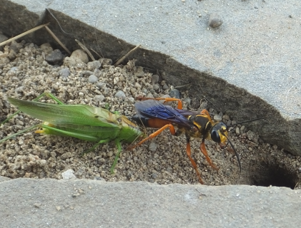
Information, Learning, and Autonomy
Sometimes agents know everything a priori (ahead of time, not through actual observation).
These agents are fragile!
Dung Beetle
Sphex Wasp
Notes:
The Dung Beetle doesn’t do perceiving or learning, it just “acts correctly” – it’s behavior is:
--roll up a lot of dung
--plug the entrance to its nest to protect its eggs.
--But if the ball of dung is removed from it’s hands en route, it will *still continue the route* -- it made the decision “OK! Time to go home!” And it doesn’t take the time to perceive anything else again until it pantomimes plugging the hole with the nonexistent dung ball.
--Evolution has taught it “once you get to this point, everything is probably going to be fine” and when it ISN’T fine it has no mechanism for correction.
The sphex wasp is another example.
--captures caterpillars and other bugs, drags it to burrow in anticipation of being a snack for eggs.
--Before taking it inside, goes into the burrow to check that everything is OK.
--Normally: comes out, finds caterpillar where it left it, drags it inside.
--BUT: if caterpillar is moved by JUST A LITTLE BIT – wasp reverts back to “drag” behavior – drags it the couple inches in front of the burrow, goes back inside to double check the burrow, even though it was *just there* and it’s *probably still fine*
--And if the caterpillar is moved again, will do this again and again and again. Doesn’t recognize or learn that this plan is failing, and thus can’t change it.

Slide 24
Information, Learning, and Autonomy
These agents are fragile. They rely solely on initial / pre-existing knowledge.
We want agents that can learn:
Update their own agent program.
An agent that can gather information and learn is said to be autonomous.
Notes:
Autonomy may come with time.
--This is not to say that initial knowledge is bad.
--We just want to supplement that with the capacity to learn / to perceive the current state.

Slide 25
Environments
Let’s shift the conversation to Environments
Agent
Environment
Sensors
?
Actuators
Notes:
So, we’ve talked a little bit about what goes into an agent here…
Let’s go into more detail about properties of environments.

Slide 26
Environment Properties
Fully observable vs. partially observable
Single agent vs. multi-agent
Deterministic vs. uncertain
Episodic vs sequential
Static vs dynamic
Discrete vs continuous
Known vs. unknown
Notes:
We’re gonna go through these one by one.

Slide 27
Environment Properties: Fully vs. Partially Observable
Fully Observable: All relevant information always immediately accessible.
Partially Observable: Some relevant information is missing; must be assumed or gathered.
Information missing due to agent’s state.
Appropriate sensors are missing or malfunctioning.
Sensory data is noisy.
No sensors at all? The environment is unobservable.
Not as hopeless as you might think!
Notes:
Missing due to agent’s state – vacuum bot with sensors that only allow it to see the current room its in but not others. As agent’s state changes, it’s ability to perceive other things (maybe at the expense of what it perceived before) comes.
Sensors are missing or malfunctioning – our poor agent might be damaged or broken.
Sensory data is noisy – it’s hard for it to tell what it is perceiving, exactly.
Unobservable, goals can actually still be achievable! We’ll discuss how later.

Slide 28
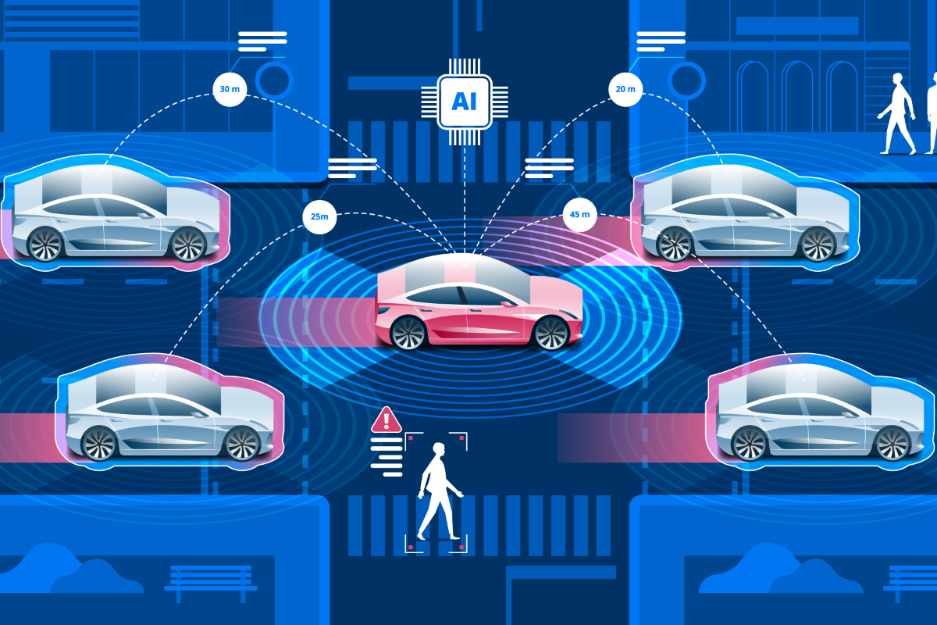

Environment Properties: Single vs. Multi-Agent
Single Agent: Everything else in the environment treated as an object.
Multi-Agent: The ‘other objects’ will change their behavior based on the actions of our agent, and thus should be considered agents themselves.
Competitive: What helps one agent might hurt another.
Cooperative: By coordinating actions, both achieve better performance.
Mix of both: Some tasks don’t fall nicely into one or the other.
Sometimes encourages randomized behavior.
cooperative multi-agent
(and mix of both)
single agent
competitive multi-agent
Notes:
We’ve talked about what a “rational agent” is and what “is” an agent, it should be noted that there isn’t necessarily a hard and fast rule about when something “becomes” an agent, or is considered an agent. Something is an agent when it becomes convenient to apply these concepts and notions to it.
Competitive: maximize one’s performance measure might hurt another’s performance. Chess is a good example – moves that are good one for one are de factor bad for the other.
Cooperative: both are maximized through team work. Imagine self driving cars – it is in everyone’s best interest to avoid crashing into each other.
Mix of Both: really, the driving is also KIND of competitive, because only one car can occupy a physical spot at a time (valuable for when there’s only one parking space, for example). So, yes, no one wants to crash into each other, but you also kinda want to get where you’re going before the other guy.
Randomized Behavior becomes rational, sometimes, in situations like these, because it helps avoid the pitfalls of predictability.

Slide 29

Environment Properties: Deterministic vs. Uncertain
Deterministic: Taking an action in a state leads to a known outcome.
Uncertain: We don’t have full confidence over what the next state will be after taking an action.
Perhaps the environment is only partially observable.
Perhaps action outcome is unpredictable.
Two flavors of uncertainty:
Stochastic: outcome probabilities are known.
Nondeterministic: outcome probabilities are not known.
deterministic
nondeterministic uncertainty
stochastic uncertainty
Notes:
Deterministic means that if we know what state we are in, every single time we are in that same state, if we take the same action, it will produce the same result, i.e., it will take us to the same other state every time.
Uncertain means we don’t have that luxury.
-- partially observable – maybe our dirt sensor is broken, so we aren’t sure if the “suck” action is going to make the room clean and add stuff to our vacuum bag, or if it will do nothing.
-- action is unpredictable – maybe we are in a multi-agent environment, and as an autonomous car we turn on our turn signal, and we aren’t sure if it it’s going to make the other agent go faster, or give us more space.
Stochastic would be a coin-flip – we don’t know if it will be heads or tails, but we know there is a 50 percent chance for either.
Nondeterministic: that “how the other car behaves” example is a good one. You can’t say “X percent of the time the person will cut you off.” Unless you see the same person on your route every day begin to pick up on patterns of behavior.

Slide 30
Environment Properties: Episodic vs. Sequential
Episodic: An agent’s current choice of actions doesn’t depend on previous choices.
Sequential: Current decision can affect all later decisions.
Some kind of long-term planning is needed.
episodic
sequential
Notes:
Episodic: kind of like an episode of a sitcom – doesn’t matter what crazy adventures they get into one week, every returns to baseline next week. You can imagine if you had a robot identifying defective parts on an assembly line – It looks at one thing, makes its decision if it’s good or bad, and that decision has no bearing on the next item it looks at. They are looked at in isolation of each other.
Sequential: you make one choice, and all subsequent choices depend on it – like every move made in chess, or in driving the car, your speed, location, direction, relative safety, etc. are all dependent on what you did the moment before, which built off of the previous moment, etc. The idea that short-term actions have long-term consequences.

Slide 31
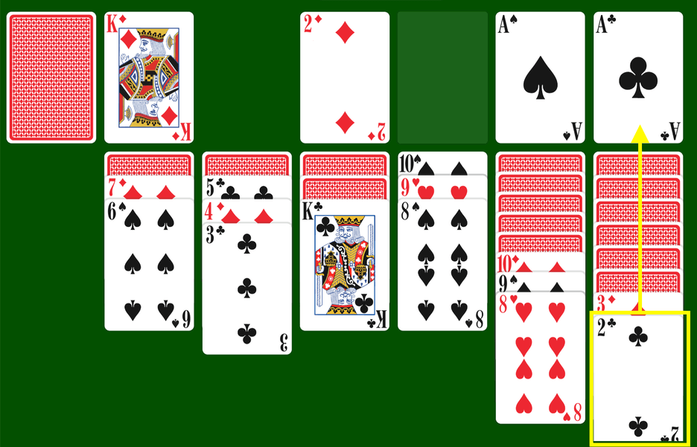
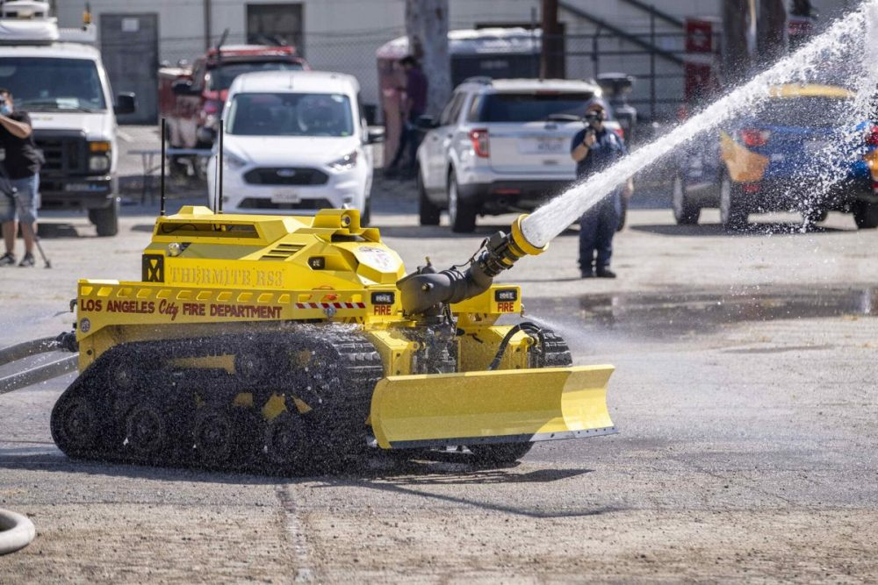

Environment Properties: Static vs. Dynamic
Static: The environment doesn’t change while the agent is thinking. Time is not a factor.
Dynamic: The environment is changing. Asks agent what they want to do next. Time is a factor.
Semi-Dynamic: only agents change the environment, but time is still a factor.
static
dynamic
semi-dynamic
Notes:
Dynamic: “asking the agent what it wants to do” as it changes. If the agent hasn’t decided yet, that counts as deciding to “do nothing” and keep deliberating.
Semi-dynamic: the environment itself isn’t changing on its own, BUT the agent’s performance score does change with the passage of time (e.g., playing chess with a clock – the faster you make the choice the better, but while it is your turn, the world itself is remaining static.

Slide 32

Environment Properties: Discrete vs. Continuous
Discrete: Everything can be clearly classified and counted:
The distinction between one action and another is clear.
The distinction between one state and another is clear.
The distinction between one percept and another is clear.
Time is separated out nicely (e.g., timestep 1, timestep 2).
Continuous: state/time/actions cannot clearly be divided into distinct classes.
E.g., taxi driving: speed and location of car and other drivers sweep through continuous range of values smoothly over time.
continuous
discrete

Slide 33
Environment Properties: Known vs. Unknown
Known: The agent understands “how the world works” Outcomes (or outcome probabilities) are all known.
Knows how the rules work.
Note: not strictly speaking a property of the environment.
Unknown: Agent doesn’t know the “laws of physics” of the environment
Will need to figure them out to be successful.
Note – this is different than fully/partially observable:
Known and partially-observable: Solitaire.
Unknown and fully-observable: first time playing a new video game.
Assuming the game is fully observable of course!
So say with Pacman: I’m saying that the AI might know how to play the game, but at first doesn’t know the movement rules for the Ghosts (but this is something that is learnable over time).
known, partially observable
known, fully observable
Notes:
And although this might feel like it has some overlap with previous concepts, it’s different!
For example, something can be known and partially-observable – a game of Solitaire. One can know all the rules of the game, understand how to play it, but the game itself is only partially observable; you don’t know the sequence of cards that are face down in the deck.
Conversely, things can be unknown and fully-observable as well. Say you are playing a video game

Slide 34
Environments
Fully observable vs. partially observable
Single agent vs. multi-Agent
Deterministic vs. uncertain
Episodic vs sequential
Static vs dynamic
Discrete vs continuous
Known vs. unknown
Notes:
So, these are all of the environments that we have. And as you might be able to tell…

Slide 35
The “Easy” Environments
Fully observable vs. partially observable
Single agent vs. multi-agent
Deterministic vs. uncertain
Episodic vs sequential
Static vs dynamic
Discrete vs continuous
Known vs. unknown
Notes:
These are the easy environments

Slide 36
The “Hard” Environments
Fully observable vs. partially observable
Single agent vs. multi-agent
Deterministic vs. uncertain
Episodic vs sequential
Static vs dynamic
Discrete vs continuous
Known vs. unknown
What set of properties defines “the real world”?
All the hard ones, of course!
Notes:
So, these are all of the environments that we have. And as you might be able to tell…

Slide 37
Guess the Characteristics: Vacuum World
A
B
Observable:
Agents:
Deterministic:
Episodic:
Static:
Discrete:
Partially
Single
Deterministic
Episodic
Static
Discrete
Notes:
So, let’s use our new vocab to define some environments.
Is vacuum world partially or fully observable?
single or multi-agent?
deterministic or uncertain?
episodic or sequential?
static or dynamic?
discrete or continuous?

Slide 38
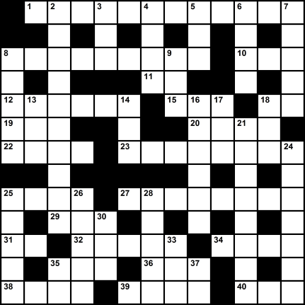
Guess the Characteristics: Crossword Puzzle
Observable:
Agents:
Deterministic:
Episodic:
Static:
Discrete:
Fully
Single
Deterministic
Sequential
Static
Discrete
Notes:
So, let’s use our new vocab to define some environments.
Is a crossword puzzle partially or fully observable?
single or multi-agent?
deterministic or uncertain?
episodic or sequential? --- sequential is the difference here! the choices you make for one word impact future answers.
static or dynamic?
discrete or continuous?

Slide 39
Guess the Characteristics: Chess
Observable:
Agents:
Deterministic:
Episodic:
Static:
Discrete:
Fully
Multi
Deterministic
Sequential
Static
Discrete
Notes:
Is a crossword puzzle partially or fully observable?
single or multi-agent? – MULTI!
deterministic or uncertain?
episodic or sequential? --- sequential is the difference here! the choices you make for one move affect future ones!
static or dynamic?
discrete or continuous?

Slide 40
Guess the Characteristics: Speed Chess
Observable:
Agents:
Deterministic:
Episodic:
Static:
Discrete:
Fully
Multi
Deterministic
Sequential
Semi-dynamic
Discrete
Notes:
Is a crossword puzzle partially or fully observable?
single or multi-agent? – MULTI!
deterministic or uncertain?
episodic or sequential? --- sequential is the difference here! the choices you make for one move affect future ones!
static or dynamic? – semidynamic – the faster you go the better!
discrete or continuous?

Slide 41
Guess the Characteristics: Poker
Observable:
Agents:
Deterministic:
Episodic:
Static:
Discrete:
Partially
Multi
Stochastic
Sequential
Static
Discrete
Notes:
Is poker partially or fully observable? – PARTIALLY!
single or multi-agent? – MULTI!
deterministic or uncertain? – UNCERTAIN, (specifically, stochastic. You have a sense as to the probabilities)
episodic or sequential? --- sequential is the difference here! the choices you make for one move affect future ones! (amount of money you have left to bet with, for example).
static or dynamic? – semidynamic – the faster you go the better!
discrete or continuous?

Slide 42
Guess the Characteristics: Taxi Driving
Observable:
Agents:
Deterministic:
Episodic:
Static:
Discrete:
Partially
Multi
Nondeterministic
Sequential
Dynamic
Continuous
Notes:
Is taxi driv ing partially or fully observable? – PARTIALLY!
single or multi-agent? – MULTI!
deterministic or uncertain? – UNCERTAIN, (specifically, nondeterministic. You have no idea as to what the other people are going to be doing)
episodic or sequential? --- sequential each choice immediately impacts the current state, which impacts what you’ll do next
static or dynamic? – dynamic – other agents are affecting the state of the world
discrete or continuous? – Continuous! Everything is happening in real time!

Slide 43
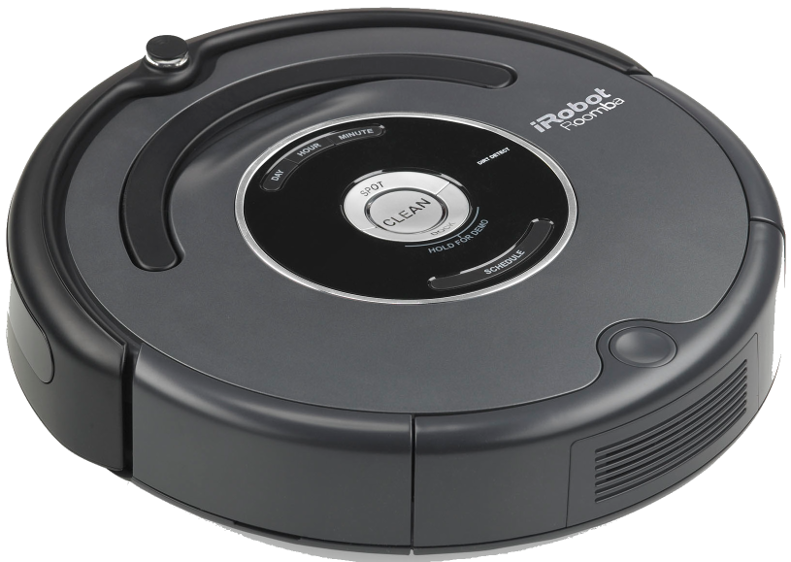
Solving Real World Problems with AI
1.) Make as many simplifying assumptions as possible.
2.) Solve the easier problem.
3.) Relax one of the simplifying assumptions.
4.) Solve the harder problem.
5.) Repeat 3 and 4 until you have solved the real world problem!
A
B
Notes:
Simplying assumptions – take all of the “hard versions” of the environment, and try to translate them to the “easy” versions.
Relax – e.g., introduce uncertainty, or a second agent.

